Slide 1

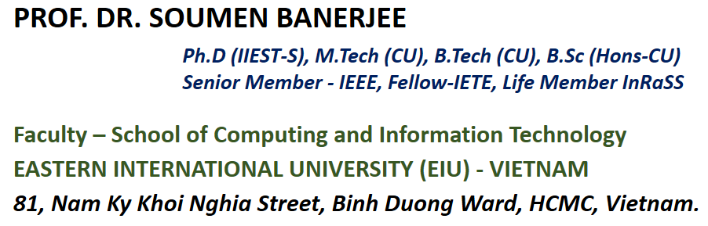

CSW-322: Machine Learning and Applications
School of Computing and Information Technology, Eastern International University (EIU) - Vietnam

Slide 2





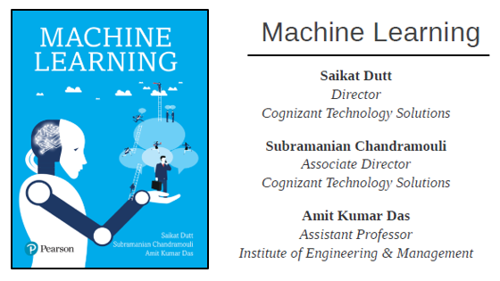

MACHINE LEARNING AND
APPLICATIONS
School of Computing and Information Technology, Eastern International University (EIU) - Vietnam

Slide 3


MACHINE LEARNING AND APPLICATIONS
Recommended Text Book –
School of Computing and Information Technology, Eastern International University (EIU) - Vietnam

Slide 4


School of Computing and Information Technology, Eastern International University (EIU) - Vietnam

Slide 5
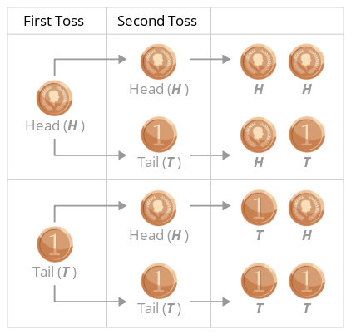
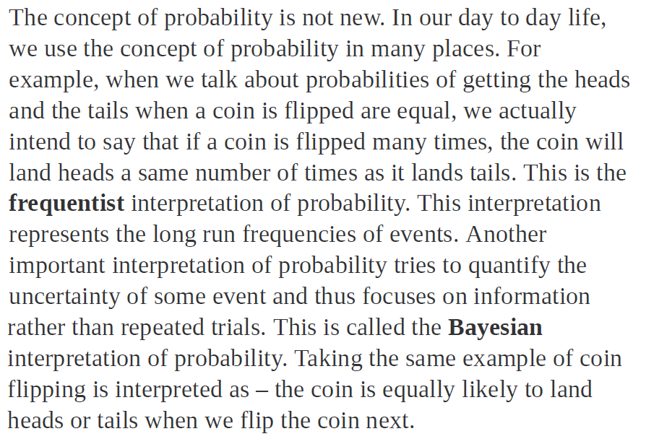
School of Computing and Information Technology, Eastern International University (EIU) - Vietnam

Slide 6

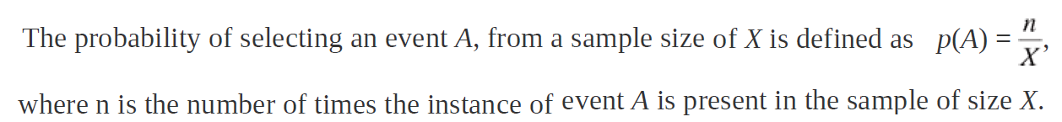
School of Computing and Information Technology, Eastern International University (EIU) - Vietnam

Slide 7
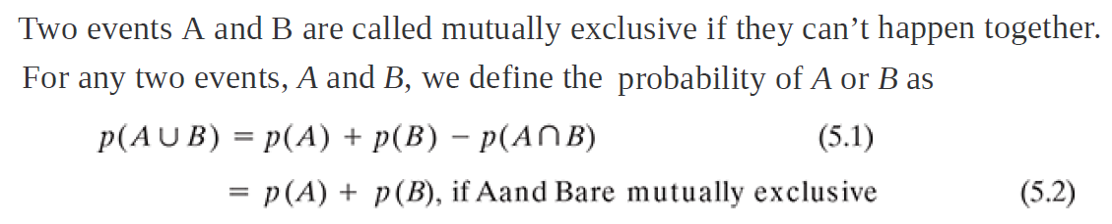

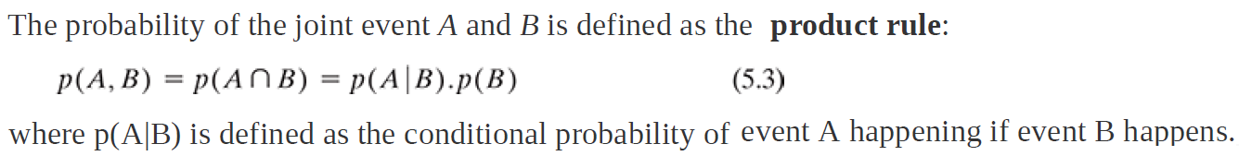
School of Computing and Information Technology, Eastern International University (EIU) - Vietnam

Slide 8
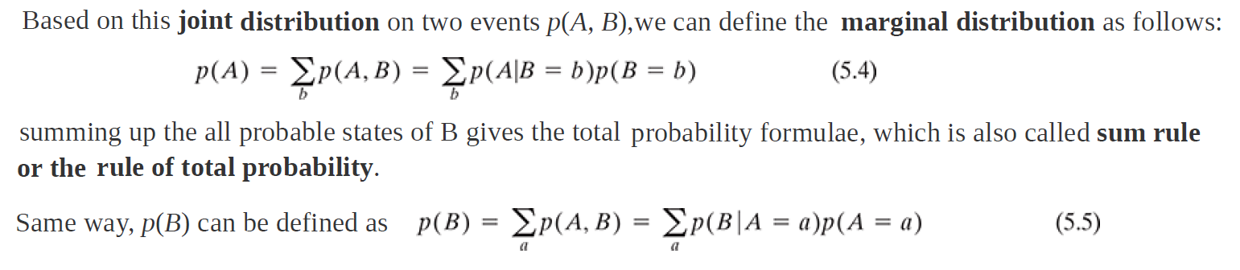
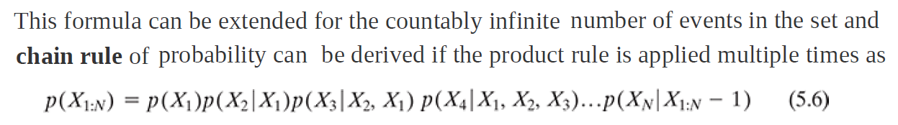
School of Computing and Information Technology, Eastern International University (EIU) - Vietnam

Slide 9

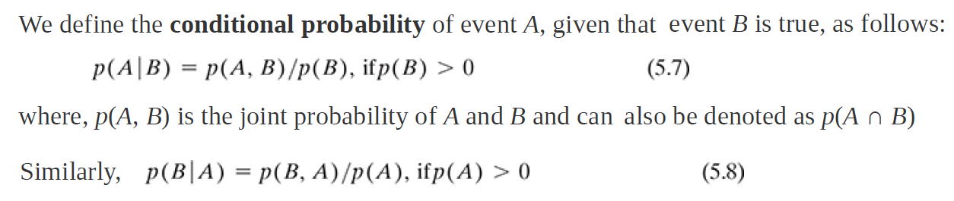

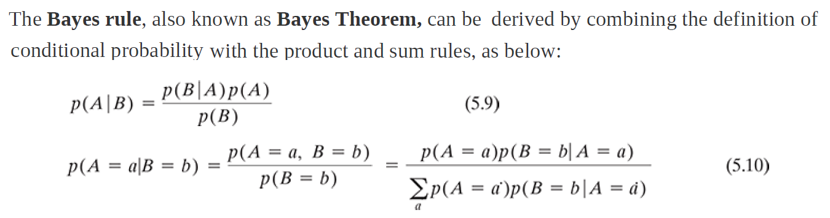
School of Computing and Information Technology, Eastern International University (EIU) - Vietnam

Slide 10
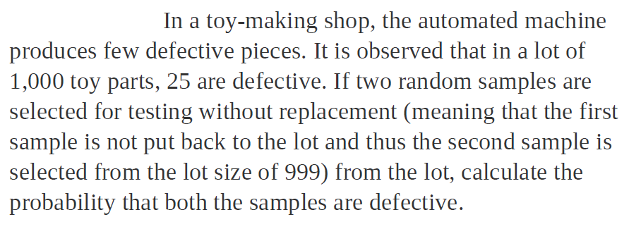

School of Computing and Information Technology, Eastern International University (EIU) - Vietnam

Slide 11

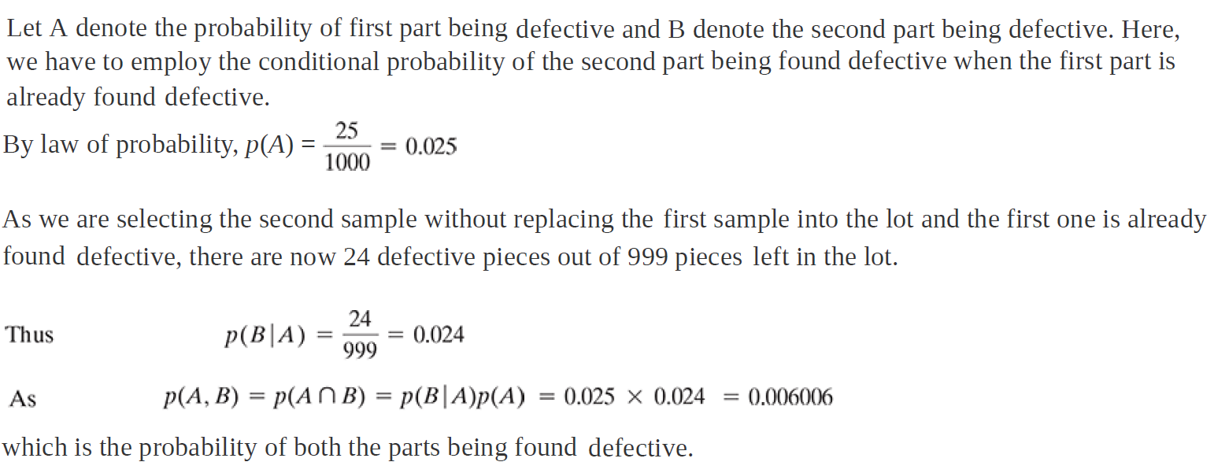
School of Computing and Information Technology, Eastern International University (EIU) - Vietnam

Slide 12
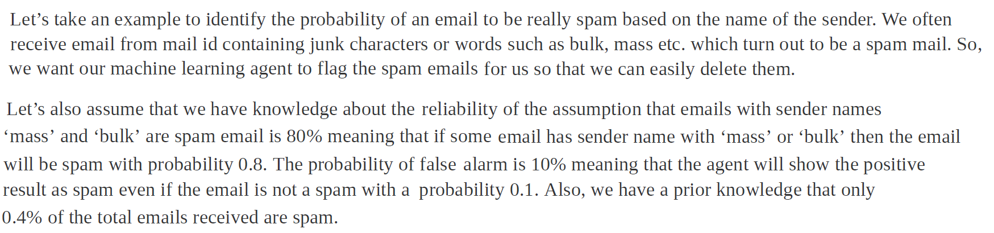
School of Computing and Information Technology, Eastern International University (EIU) - Vietnam

Slide 13
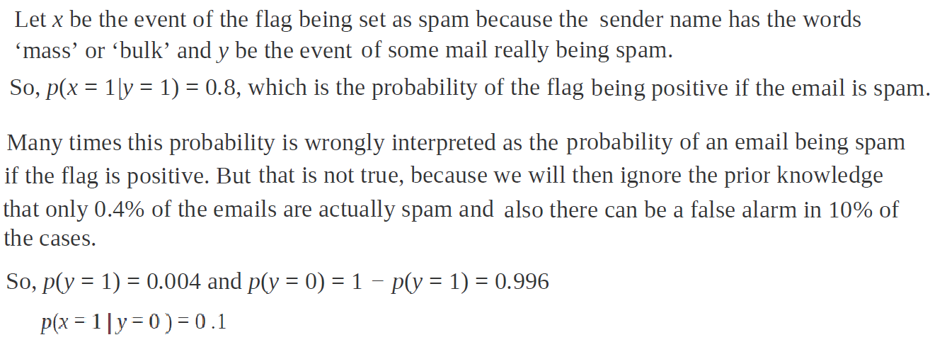
School of Computing and Information Technology, Eastern International University (EIU) - Vietnam

Slide 14
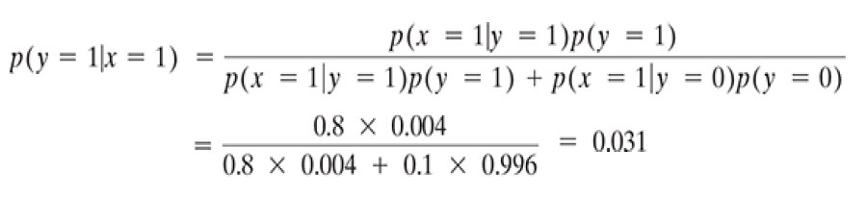
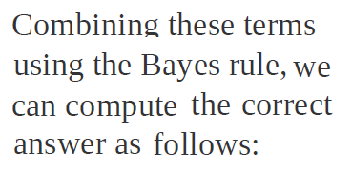
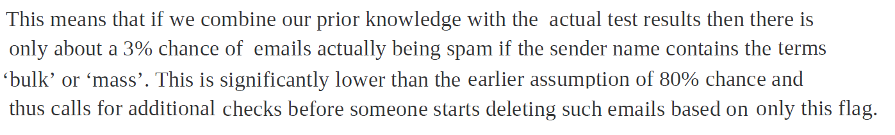
School of Computing and Information Technology, Eastern International University (EIU) - Vietnam

Slide 15

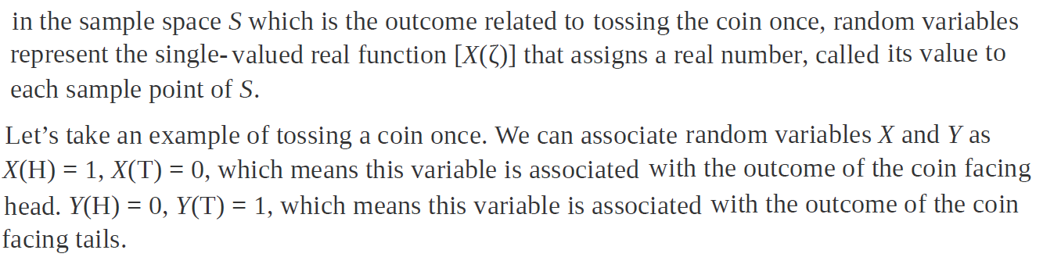
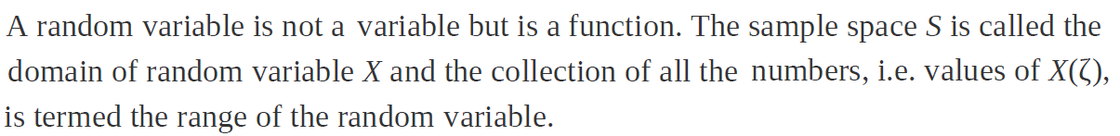
School of Computing and Information Technology, Eastern International University (EIU) - Vietnam

Slide 16
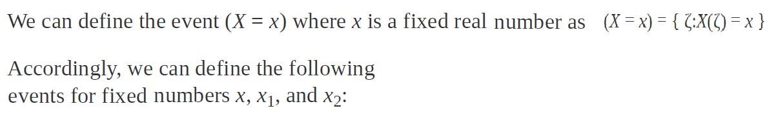
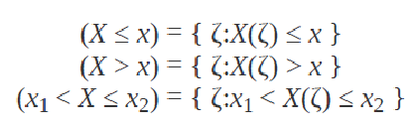
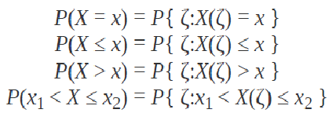
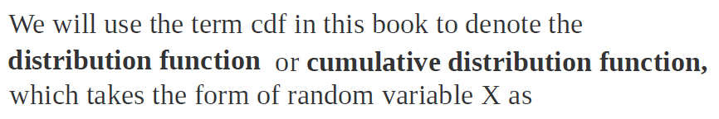

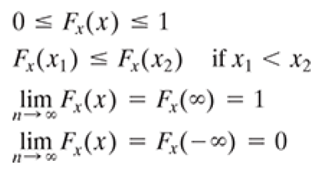
School of Computing and Information Technology, Eastern International University (EIU) - Vietnam

Slide 17

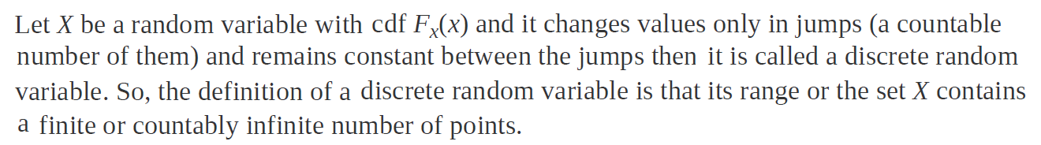
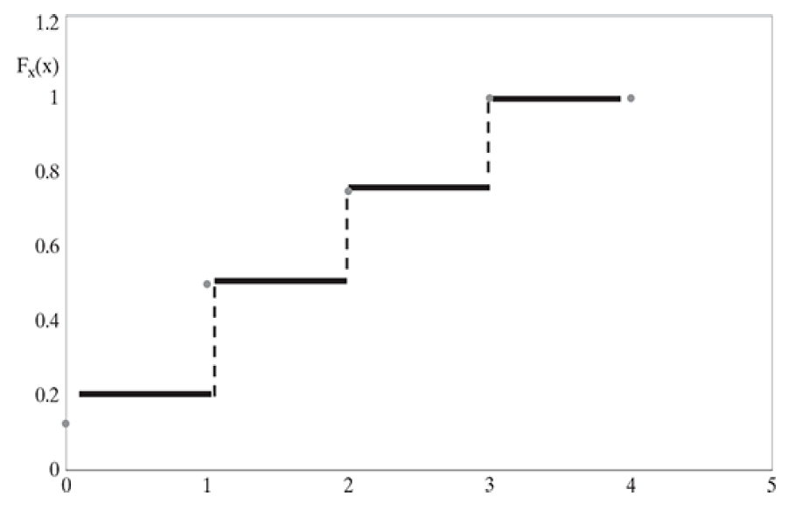
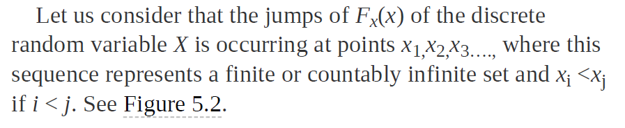
School of Computing and Information Technology, Eastern International University (EIU) - Vietnam

Slide 18
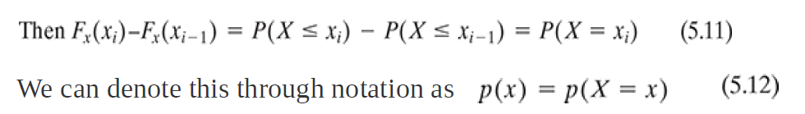
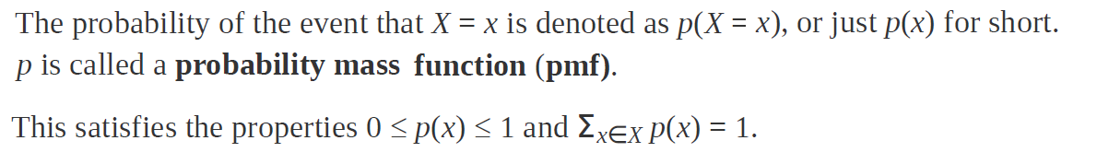
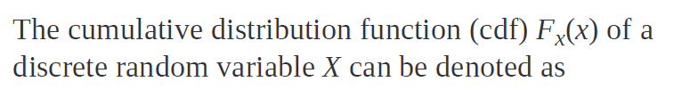
School of Computing and Information Technology, Eastern International University (EIU) - Vietnam

Slide 19

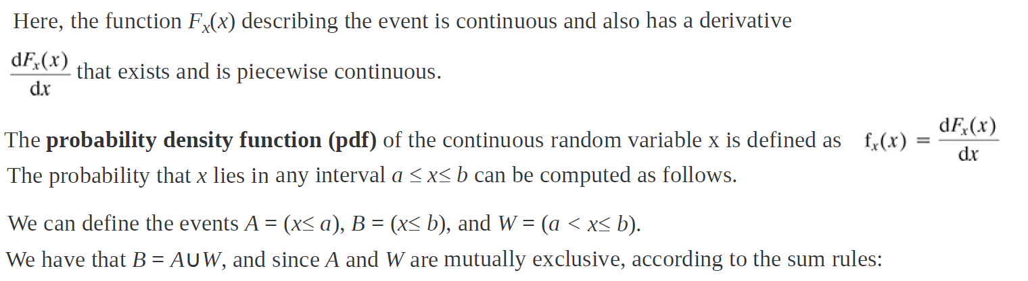
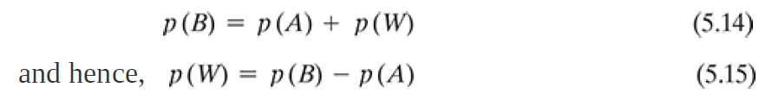
School of Computing and Information Technology, Eastern International University (EIU) - Vietnam

Slide 20
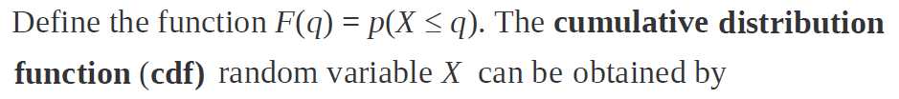




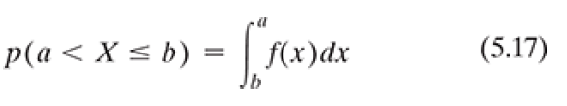
School of Computing and Information Technology, Eastern International University (EIU) - Vietnam

Slide 21

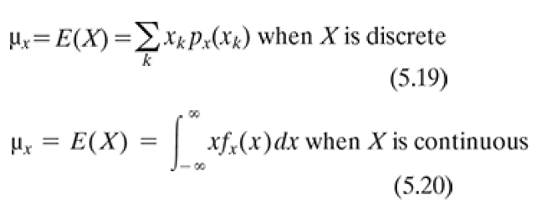
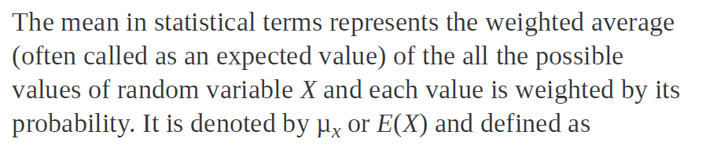

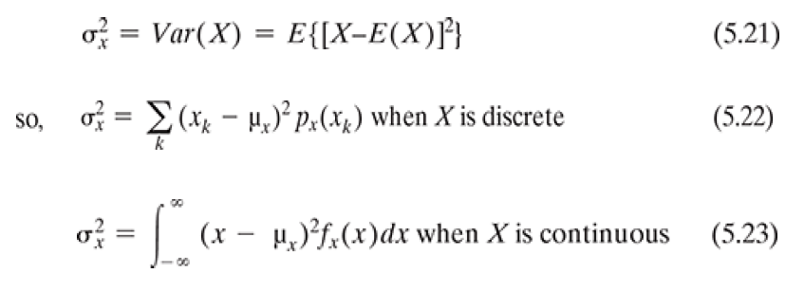
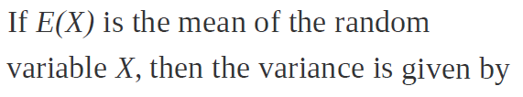
School of Computing and Information Technology, Eastern International University (EIU) - Vietnam

Slide 22


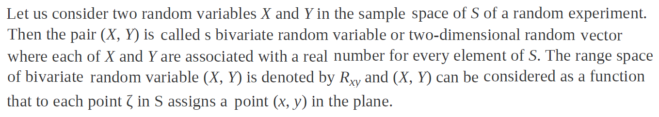
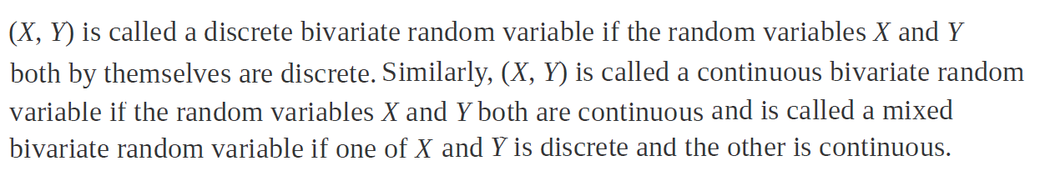
School of Computing and Information Technology, Eastern International University (EIU) - Vietnam

Slide 23

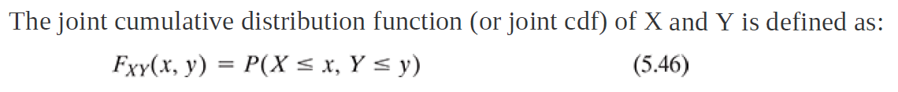
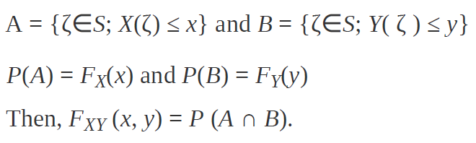
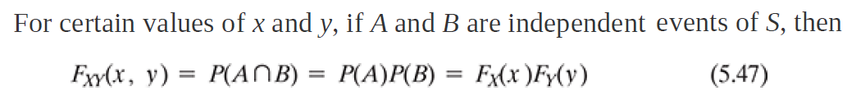
School of Computing and Information Technology, Eastern International University (EIU) - Vietnam

Slide 24
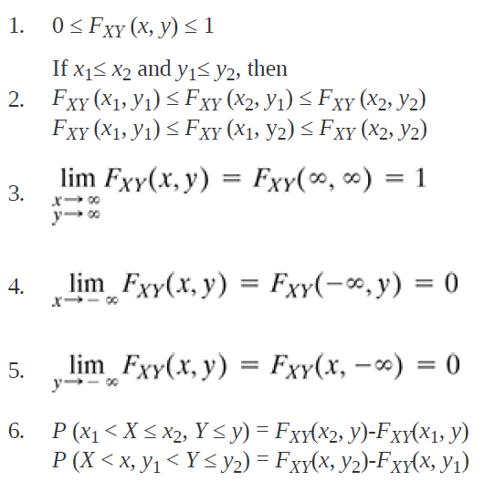
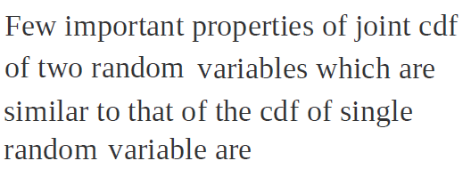
School of Computing and Information Technology, Eastern International University (EIU) - Vietnam

Slide 25
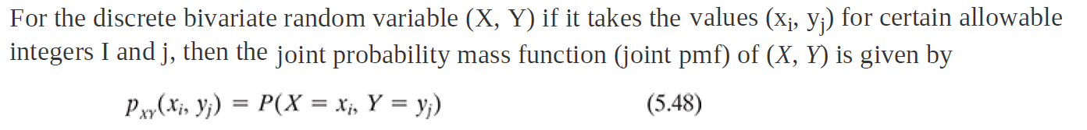
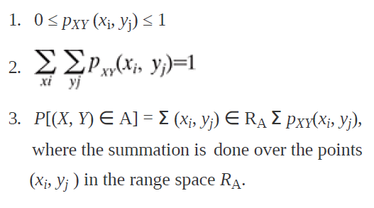


School of Computing and Information Technology, Eastern International University (EIU) - Vietnam

Slide 26
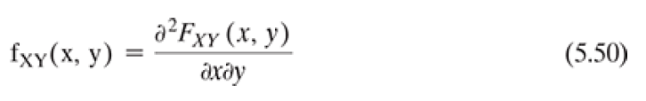
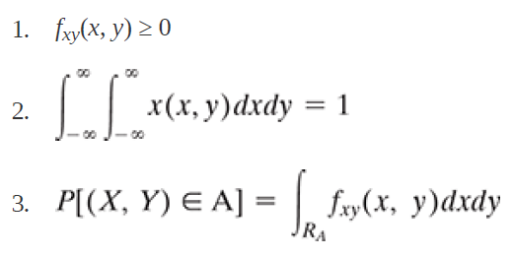

School of Computing and Information Technology, Eastern International University (EIU) - Vietnam

Slide 27




School of Computing and Information Technology, Eastern International University (EIU) - Vietnam

Slide 28



School of Computing and Information Technology, Eastern International University (EIU) - Vietnam

Slide 29

School of Computing and Information Technology, Eastern International University (EIU) - Vietnam

Slide 30


School of Computing and Information Technology, Eastern International University (EIU) - Vietnam

Slide 31


School of Computing and Information Technology, Eastern International University (EIU) - Vietnam

